Slide 1
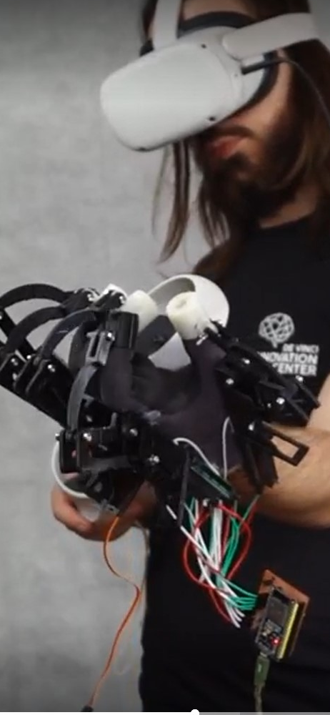
The use of haptics to improve VR experience
ExoTouch: Building of a VR haptic Exoskeleton
Gauthier Gendreau
Notes:
Touching objects that doesn’t exist or on the other side of the planet

Slide 2
What is "haptics"?
1/13
Why is it important in VR?
My vision
Notes:
Use haptics to enhance immersion in VR and telepresence and to make it available to the larg public and use it’s full potential.
Présenter pk on se focus sur qq chose de wearable

Slide 3
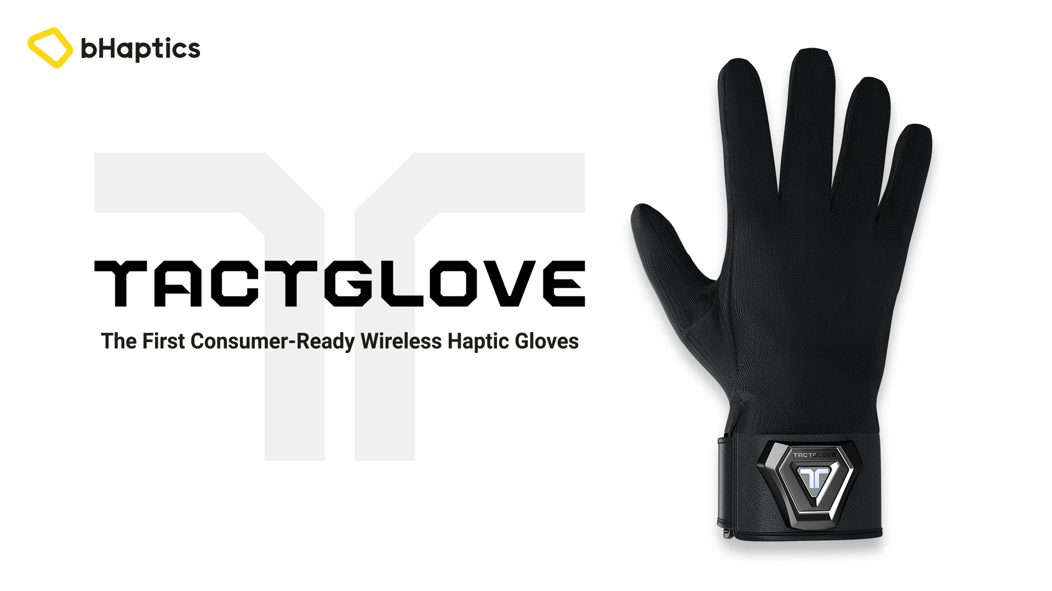
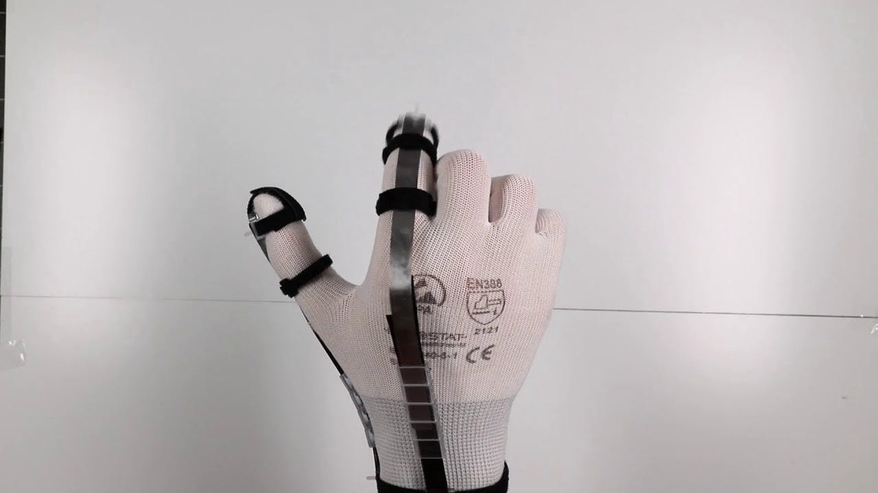
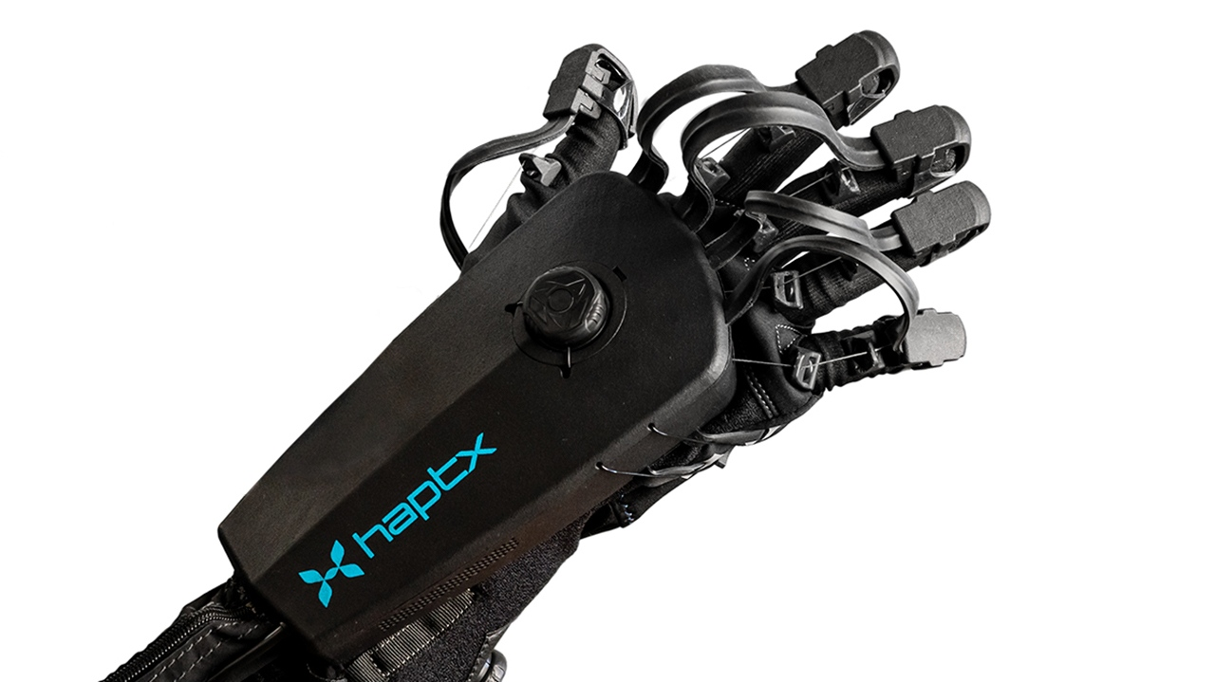
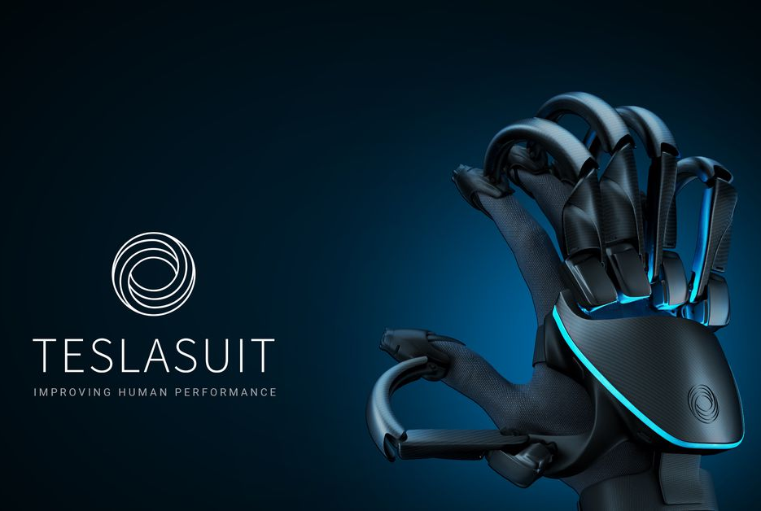
2/13
Gloves in the market
[1]
[4]
[3]
[2]
1-TactGlove by bHaptics, a glove with vibrating motors on each fingers – price: 299$
4-Hinchet, R., Vechev, V., Shea, H. and Hilliges, O., 2018, October. Dextres: Wearable haptic feedback for grasping in vr via a thin form-factor electrostatic brake. In Proceedings of the 31st Annual ACM Symposium on User Interface Software and Technology (pp. 901-912).
2-TeslaSuit gloves, a glove with vibrating motors and force-feedback – price: 5000$
3-Gloves DK2 by HaptX, a glove with vibrating motors and force-feedback – price: at least 4000$

Slide 4
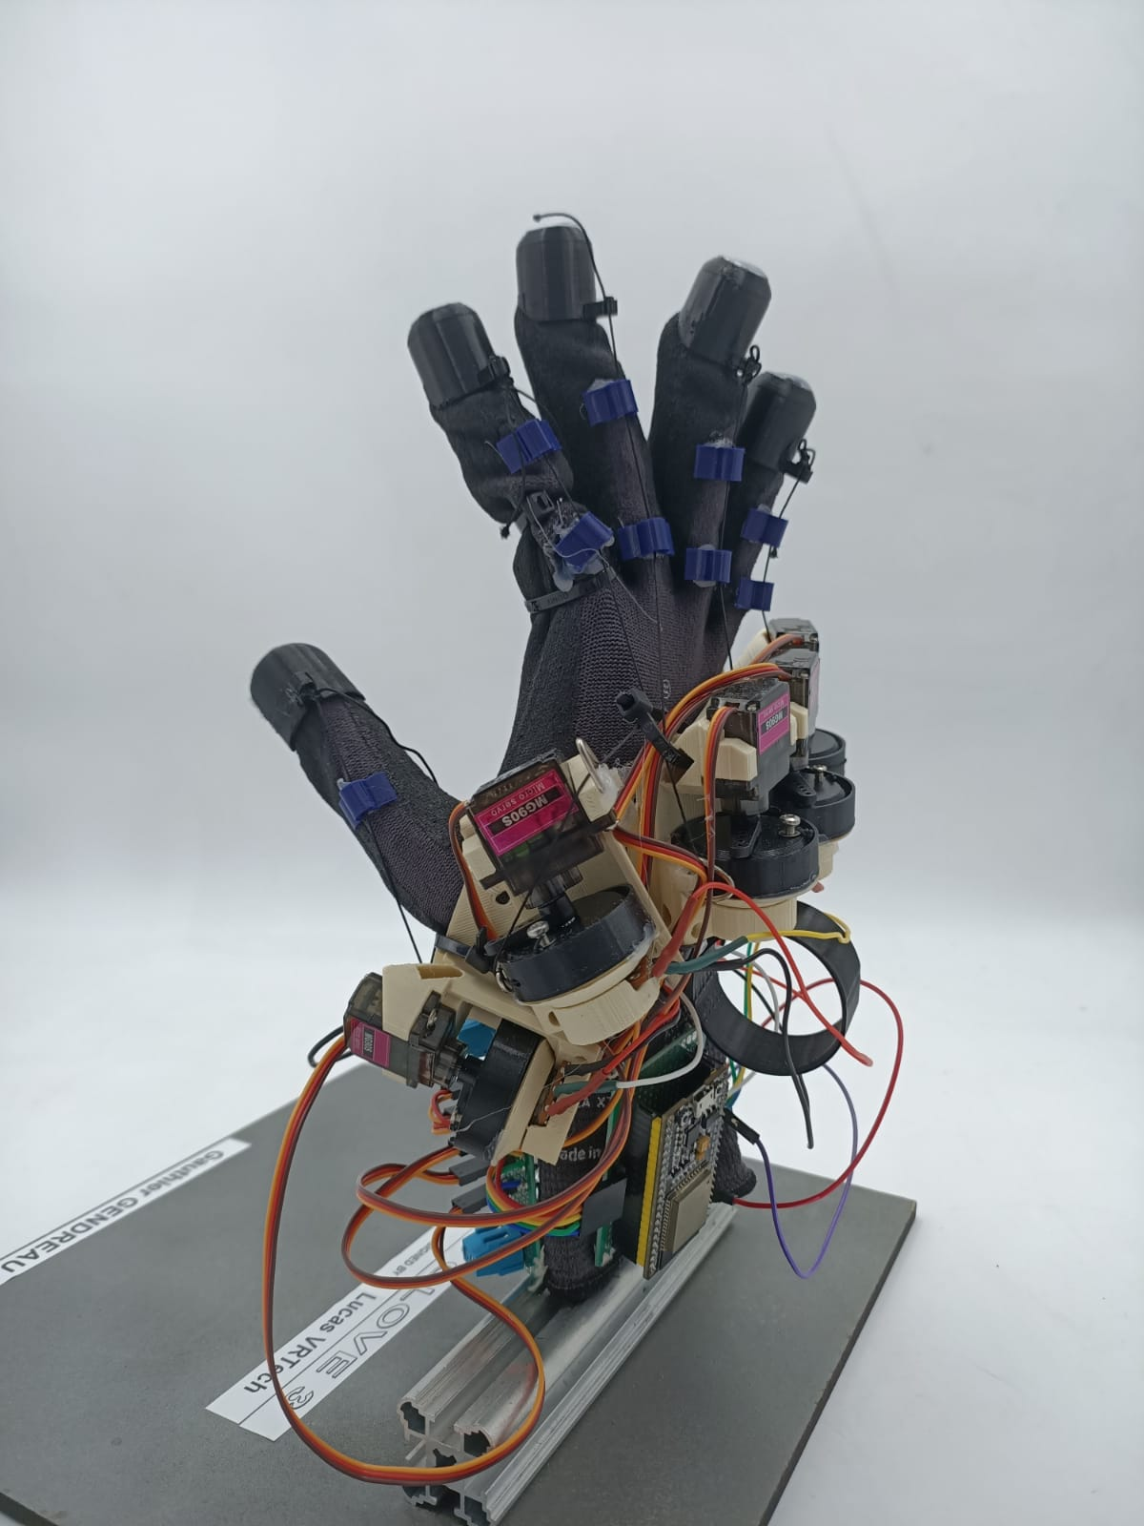
3/13
Lucid Glove v4
First prototype built and tested
DVIC’s version of the lucid glove designed by Lucas VRTech (MIT)

Slide 5
4/13
Lucid Glove v4
First prototype built and tested
+
-
Very cheap (60$)
Easy to build and well documented
Highly reusable driver
First touch to VR haptics
Quite heavy
Constantly present recall force
Have to be calibrated very often
The sensations are poor

Slide 6
ExoTouch
5/13
Build a reliable haptic exoskeleton for less than 200€ per hand
Notes:
Expliquer pk c’est dégeu un gant

Slide 7
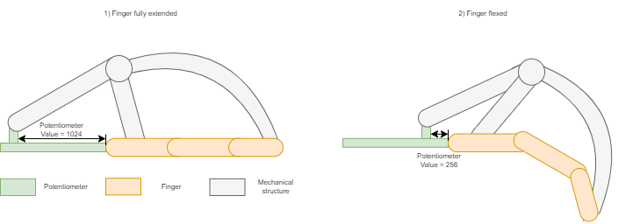
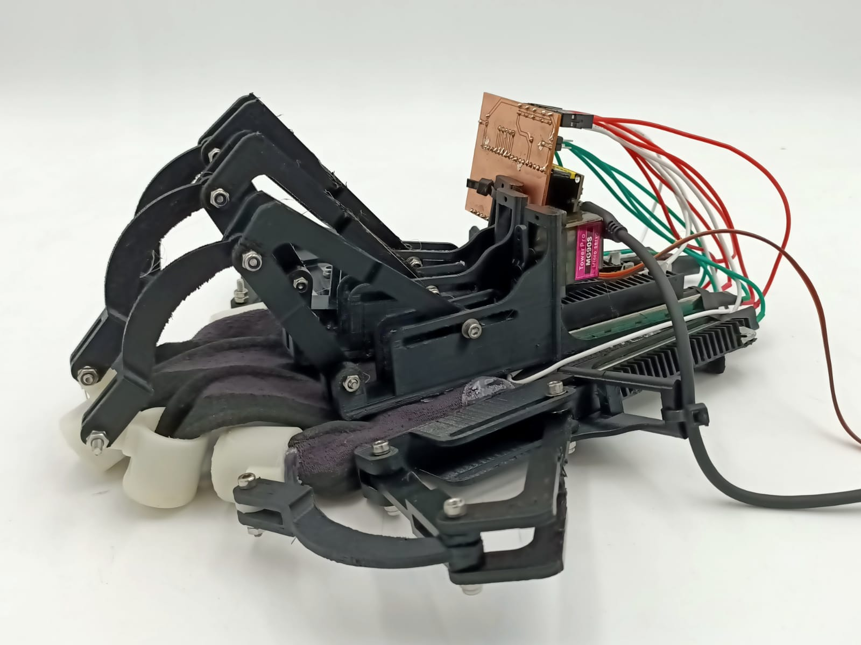
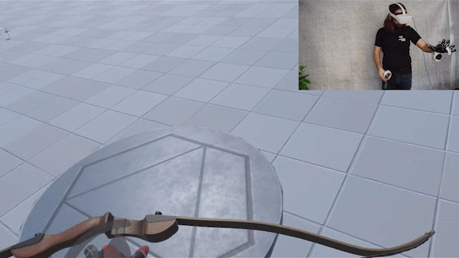
6/13
ExoTouch V1
100% hand made at DVIC
Notes:
-Focus sur le hand tracking + abandon des fils pour éviter les ressorts

Slide 8
7/13
ExoTouch V1
First prototype built and tested
+
-
Very sensitive
Possibility to upgrade to an exoskeleton
Can be adapted to a wide variety of hands
Big and heavy
No working force feedback

Slide 9
ExoTool
8/13
Develop a new pipeline to debug and test haptic devices

Slide 10
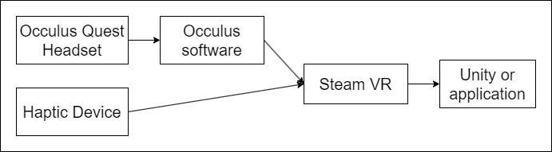
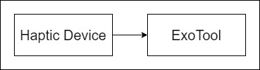
9/13
ExoTool
Old debugging pipeline
New debugging pipeline

Slide 11
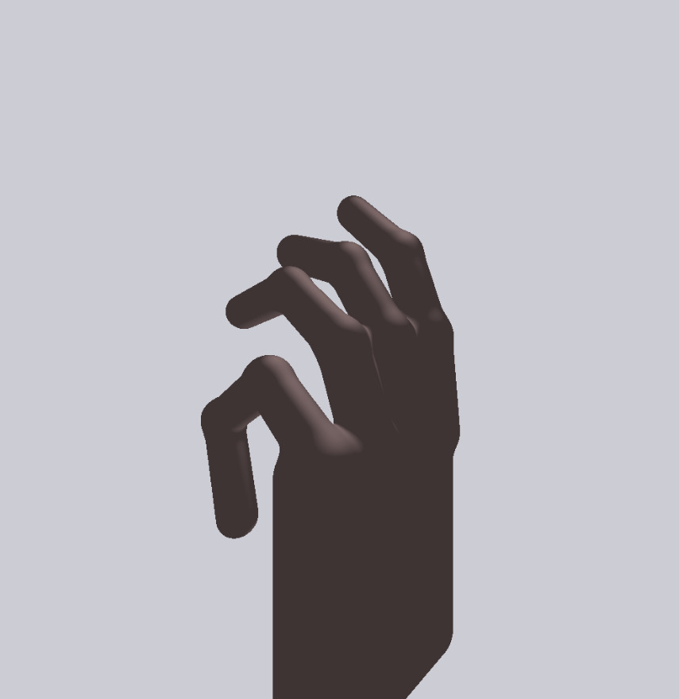
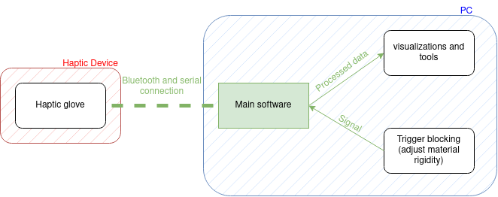
10/13
ExoTool

Slide 12
Future Works
11/13

Slide 13
12/13
Future works
The next two months
Before the internship
Miniaturisation
Transfer to exoskeleton
Make the force feedback " analogic "
User study
Extend the use of the ExoTouch to the telecontrol of a humanoid robot.
Next year
Extend the haptic exoskeleton to all the upper body.

Slide 14
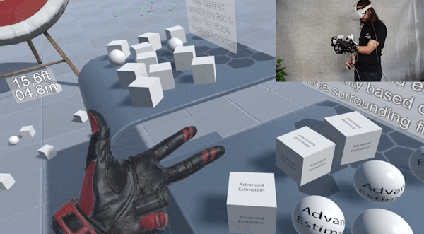
13/13

Slide 15
Thank you!
Gauthier Gendreau
Notes:
Touching objects that doesn’t exist or on the other side of the planet

